Slide 1


Dialogs in Microsoft Teams (Extended lab)

Slide 2
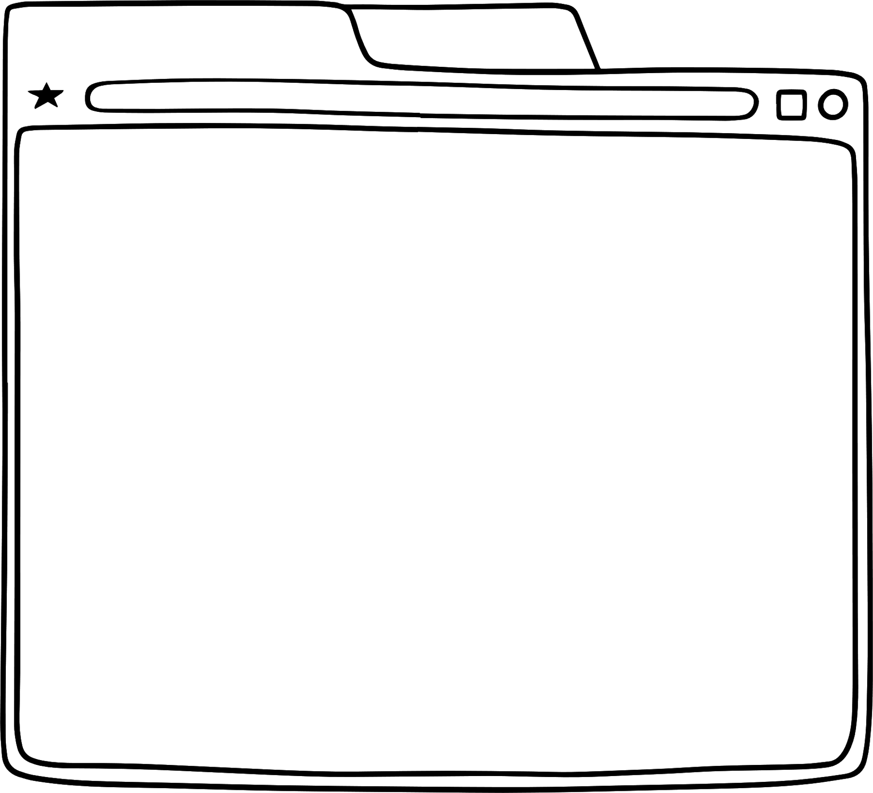




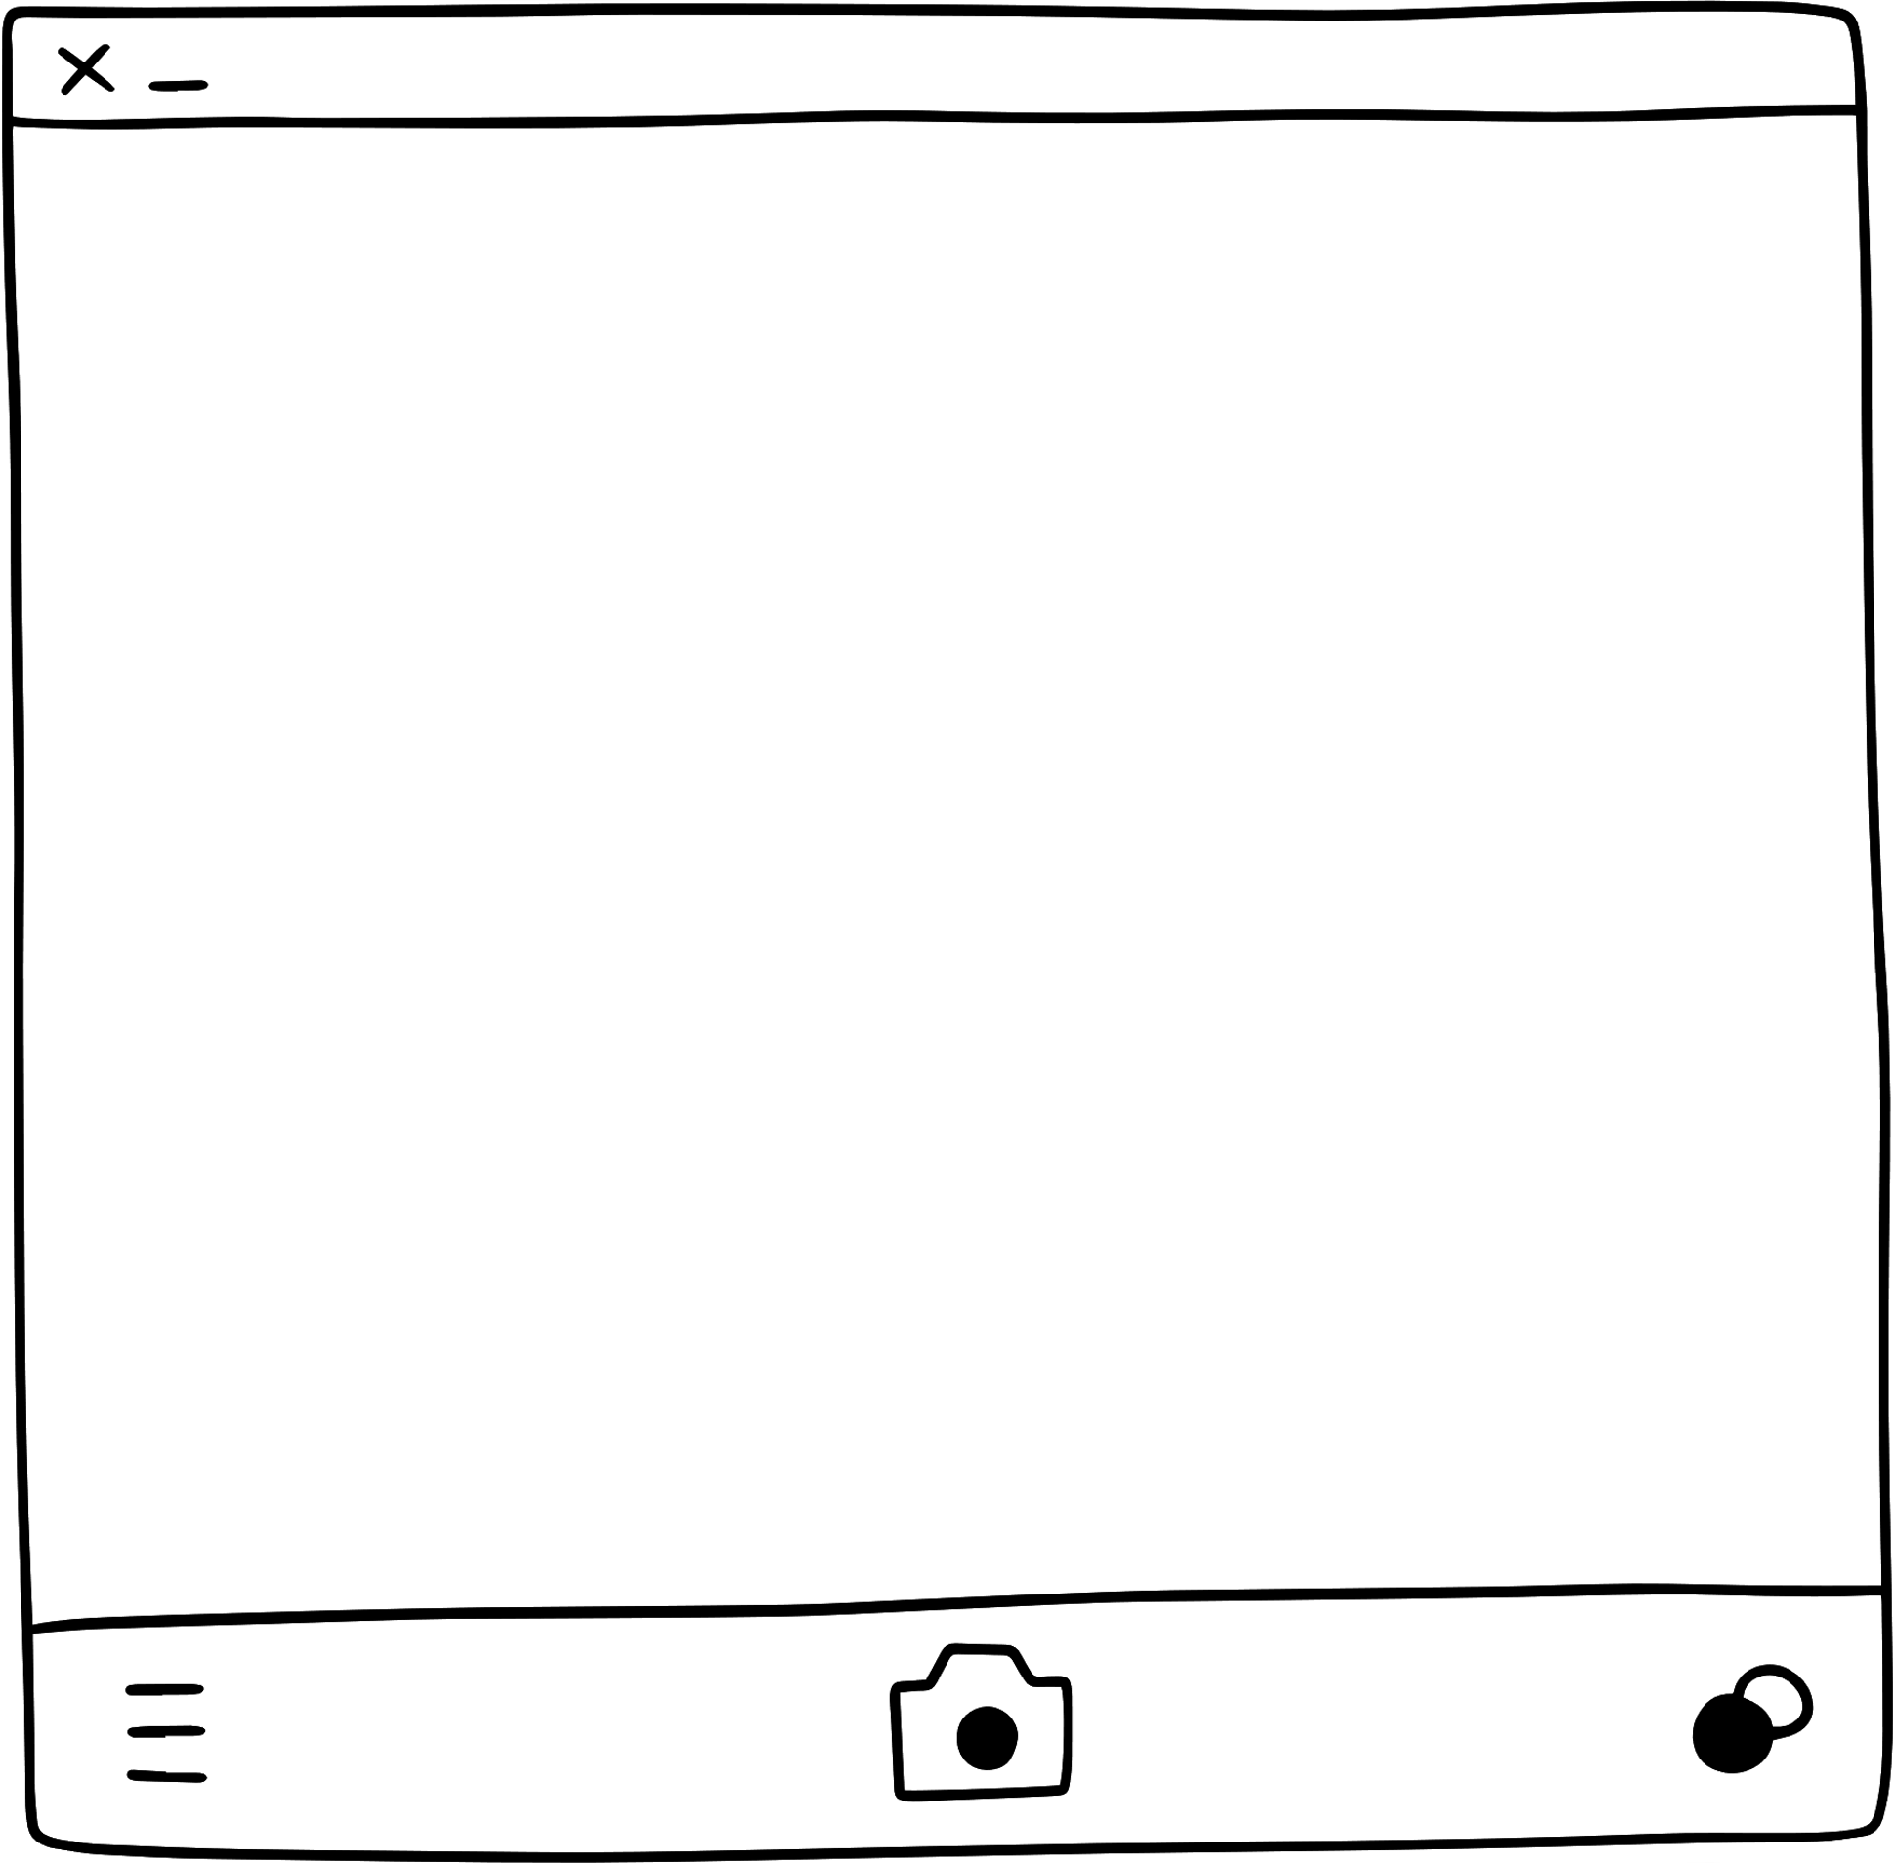


Formerly known as Task Modules!
Dialogs
Modal pop-up experiences in Teams application that can display: - web pages as IFrames - adaptive cards
Notes:
Dialogs as they are called in version 2 of the teams js SDK are modal pop-up experiences in Teams application that can display web pages as IFrames or adaptive cards. This can greatly simplify the user experience when a data input is required and gives your application an opportunity to interact one-on-one with a user even in a group environment.
What you’ll learn:
How to build a Dialog using a web page
How to launch a dialog from a tab using the Teams JavaScript SDK
How to submit data from the dialog back to the tab that launched it

Slide 3

demo
Notes:
Lab demonstration:
- Show the lab working by adding notes to an order. Point out it’s just a simulation and the notes aren’t saved in the database.
- Show /client/pages/orderDetail.js in the completed project and view the btnTaskModuleElement event listener. Point out that it politely checks to make sure the current hosting environment supports dialogs – this is for the future when your app might run in other parts of Microsoft 365. The code constructs a taskInfo object with all the details including the URL of the web page that will appear and a submit handler that will receive data back from the dialog
- Show /client/pages/orderNotes.js. Point out that the page uses microsoftTeams.dialog.submit() to submit data back to the application

Slide 4
LAB TIME https://aka.ms/app-camp Please do the Dialogs extended lab
Notes:
Note there is a video for each lab showing a complete walk-through

Slide 5



Lab Structure
Core Lab (path A)
App setup
Add tab with SSO
Add look and feel
Migrate an Azure AD Web App to Teams
start
Personal tab with
Azure AD SSO
Core Teams Application
Configurable
tab
Deeplinks
Dialog
Meeting App
Message Extension w/Adaptive Cards
Extend capabilities
Notes:
ASK ONE OF THE PARTICIPANTS TO DEMO THE APP

